Slide 1
Interpolation - Newton’s Forward and Backward Interpolation Formula
Course Instructor
Engr. Rahemeen
Rahemeen.bukc@bahria.edu.pk

Slide 2
Interpolation
Forward
Interpolation
Interpolation formula is a method to find new values of any function using the set of available values through interpolation.
It is an important statistical tool used to calculate the value between two points on the curve of a function from the given points which also lie on the same curve.
Differences:
The differences y1 – y0, y2 – y1, y3 – y2, ……, yn – yn–1 when denoted by dy0, dy1, dy2, ……, dyn–1 are respectively, called the first forward differences. Thus, the first forward differences are :

Slide 3
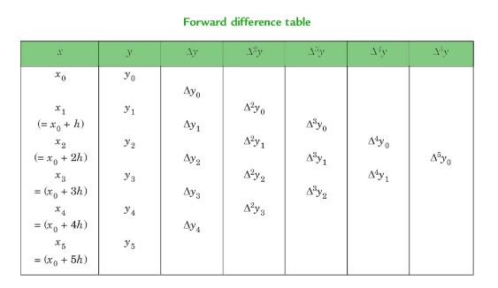

Slide 4
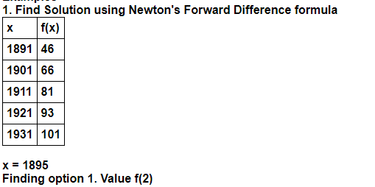
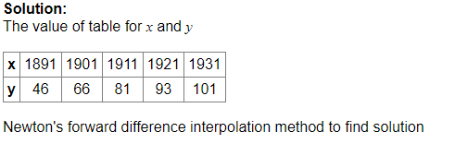
Example 1

Slide 5
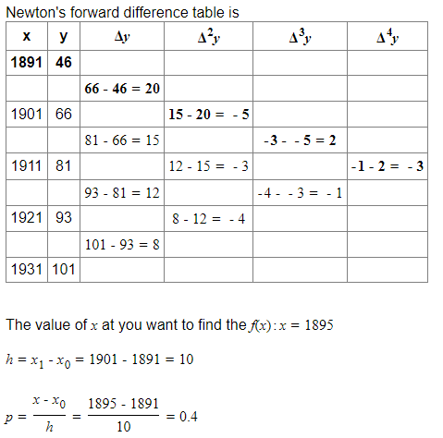

Slide 6
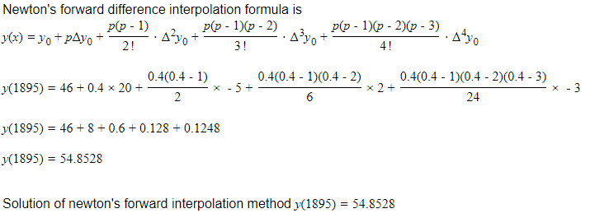

Slide 7
Example 02
Form a difference table and interpolate the value of f(x) when x=4 given :
x | 3 | 5 | 7 | 9
f(x) | 180 | 150 | 120 | 90

